Slide 1
Hotel Industry Final
The Harjass Hotel
PRESENTED TO: Aj.Atikom Srivallop
ITE 354 - Business Intelligence
OLIVIA PARRY: 215210064
ATTAHPHOL KUKREJA: 215210032
PONGSAKORN TANUPATRASAKUL: 1702060008
PANSAWUT KANJAPLEE: 215310020

Slide 2
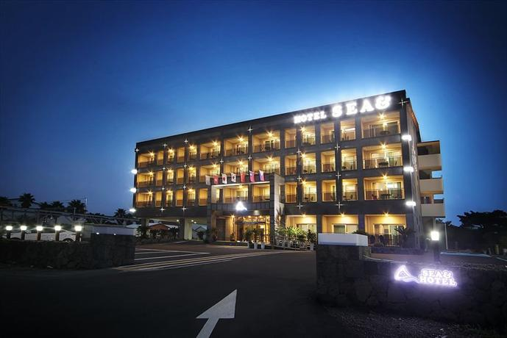
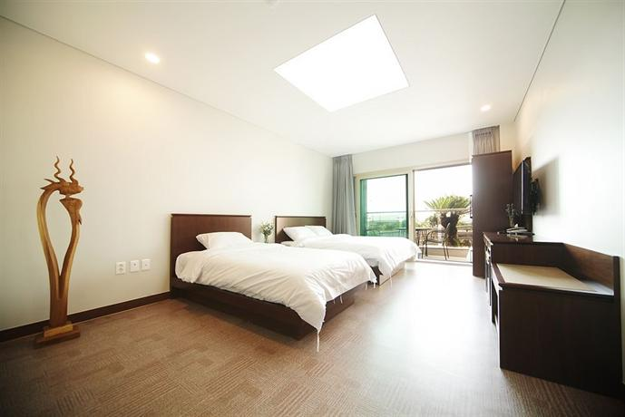
Introduction
We Chose Hotel Industry for our Business Intelligence Project.
We named our hotel as “Harjass Hotel”
We interviewed members of the Hotel Industry for the accuracy in building the dashboard for our project.
We have analysis data of the profit and the revenue of the hotel between the year of 2017-2019

Slide 3
Current Customer
This page shows all the information related to our current customers in the hotel.
We added a pie chart that shows on how the customers are finding our hotel. Ex: Facebook Ad, Magazine, Reference by a friend, Search engine or so.
We added a pie chart that shows what kind of room in the hotel is most prefered by our customers. In our ase it is the Twin Room.
We also added the map that shows from which nationality of customers are regular to our hotel. In our case it is the Chinese Nationality.

Slide 4
Income, Spending, Profits.
We have a graph to easily show the income and spending of the hotel.
Along with 2 cards to show the income, spending and then also the profit.
It can be filtered by year & month.

Slide 5
Income per Category
As the third dashboard page, we included the Income per category.
Basically, as a Hotel has many internal facilities, We tried to calculate the income that the hotel earns from other extra facilities that are provided to the customers. Facilities such as Gift shops, Restaurants, Spa, and more.

Slide 6
Booking Information
We have a bar graph to show the total bookings per month.
A card to show the total bookings in figures and a card to show the room types.

Slide 7
Feedback
An important aspect to Hotel industry is the feedback and customer satisfaction.
6 Satisfaction Scales for different aspects of our hotel.

Slide 8
THANK YOU

